Slide 1
Electric Fields & Magnetic Fields
Year 12

Slide 2
Page Setup
Set up the first page of every lesson like this and rule a column line for every page after the first page that is used during the lesson.
Focus: State the Chapter Number, Title and the page numbers
(3 lines).
Keywords: During the lesson write out your own keywords used during the lesson. (8 lines)
Context: During the lesson write in this section what this topic relates to in the ‘real’ world. How is this content used to better society? (5 lines)

Slide 3
Electric Field
Chapter 3.1
Page 72 - 82

Slide 4
Atomic charge
The nucleus contains most of the mass of an atom, but occupies the smallest part of the atoms volume.
The electrons are the significant component of an atom when discussing electrical charge. The excess or lack of electrons determines an atoms charge.
The unit of charge is measured in Coulombs (C).
1 electron has a charge of 1.602 x 10⁻¹⁹ C

Slide 5
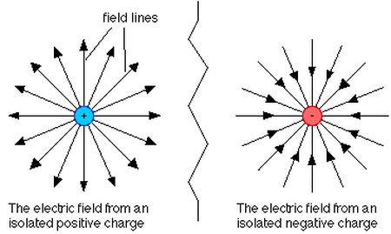
DRAWING AN Electric Field
Field lines are representations of the forces a charge experiences.
Field lines must enter and leave at 90º to the tangent of the object.
Arrows must show field lines
entering a negative charge
exiting a positive charge
Draw about 8 field lines on each charged object.

Slide 6
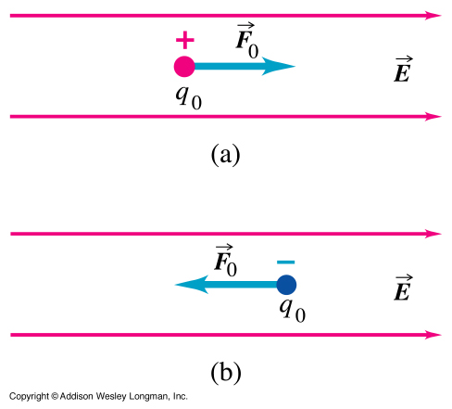
Electric Field
An electric field only exists if a charge experiences a force.
An electric field exerts a force in the direction of the field on a positive charge, and in
the opposite direction on a
negative charge.

Slide 7
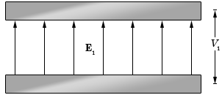
Electric Field
E = F .
q E – electric field (N C⁻¹)
F – force (N)
q – charge (C)
E = V .
d E – electric field (V m⁻¹)
V – voltage (V)
d – distance (m)
Note E (N C⁻¹) = E(V m⁻¹)

Slide 8
ELECTRIC FIELD
Example 3.1a: The deflection of the beam in a T.V occurs by passing electrons between two parallel charges plates 4 cm apart. Calculate the force on an electron passing through the plates if the voltage across them is 350 V and q = 1.6 x 10⁻¹⁹ C.

Slide 9
ELECTRIC FIELD
Example 3.1b: Robert Millikan measured the charge on an electron by finding the electric force on tiny oil drops in a known electric field. If the force on an oil drop was due to the charge of one single extra electron on the drop, and was found to be 8.0 × 10^{–14} N upwards, what was the strength and direction of the electric field he was using?

Slide 10
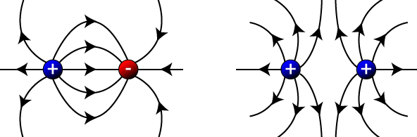
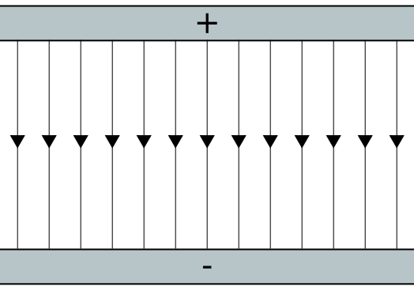
ELECTRIC FIELD LINES
Example 3.1c: Draw field lines for the following
a) A -1 C point charge near a +1 C point charge
b) Two +1 C positive charges near each other.
c) A positive plate parallel to a negative plate
a) b) c)

Slide 11
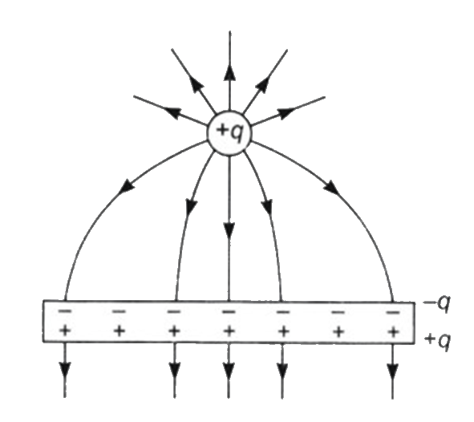
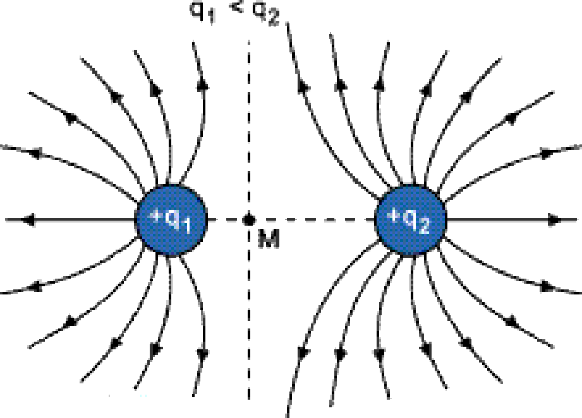
ELECTRIC FIELD LINES
Example 3.1c: Draw field lines for the following
d) A +1 C point charge near a neutral plate
e) Two positive charge, where q₁ < q₂.
d) e)

Slide 12
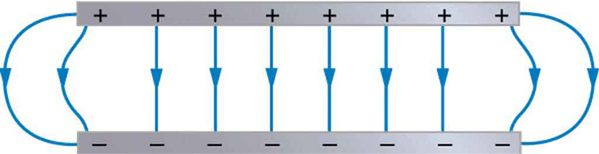
ELECTRIC FIELD
Example 3.1d: A droplet with 7 extra elecrons is suspended between two charged plates of unknown potential difference. If the droplet has a mass of 3 × 10⁻⁸ g and the distance between the plates is 1.5 mm. What is the minimum potential difference in order to keep the droplet suspended?

Slide 13
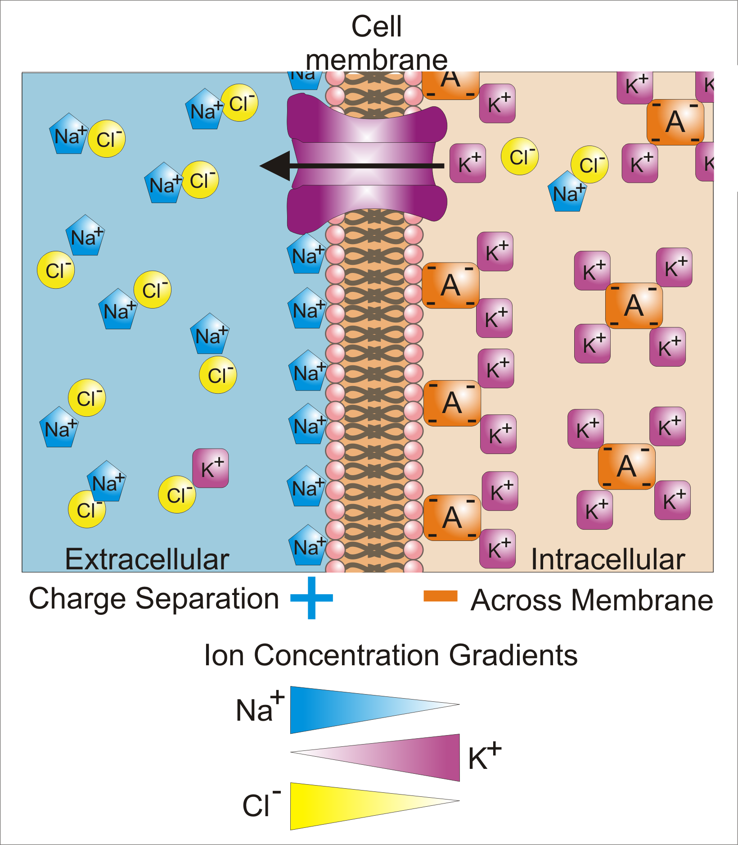
ELECTRIC FIELD In Humans
The membrane serves as both an insulator and a diffusion barrier to the movement of ions.
Membrane potential (also membrane voltage) is the difference in electric potential between the interior and the exterior of a biological cell. With respect to the exterior of the cell, typical values of membrane potential range from –40 mV to –80 mV.

Slide 14
Homework, Context & Keywords
Context: How is this content used to better society?
Understanding ion distribution in body cells, and how transportation of nutrients successfully passes through the cell membrane.

Slide 15
Homework, Context & Keywords
Key Words
Electrostatic
Electric field
Positive charge
Negative charge
Electric field lines
Point charge

Slide 16
Homework, Context & Keywords
Homework
Complete all questions from Set 3.1- due first lesson next week.
Read Chapter 3.2, page 82-84 and answer
Q1 Set 3.2
by next lesson.

Slide 17
Page Setup
Set up the first page of every lesson like this and rule a column line for every page after the first page that is used during the lesson.
Focus: State the Chapter Number, Title and the page numbers
(3 lines).
Keywords: During the lesson write out your own keywords used during the lesson. (8 lines)
Context: During the lesson write in this section what this topic relates to in the ‘real’ world. How is this content used to better society? (5 lines)

Slide 18
COULOMB’s LAW
Chapter 3.2
Page 82 - 84

Slide 19
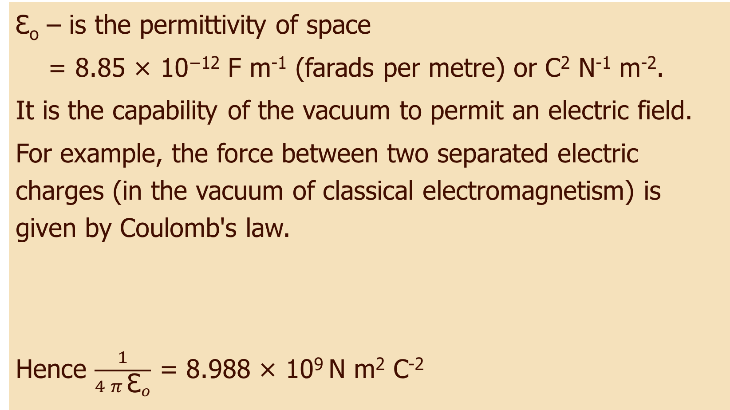
Permittivity of Free Space
Ɛ_{o} – is the permittivity of space
= 8.85 × 10⁻¹² F m⁻¹ (farads per metre) or C² N⁻¹ m⁻².
It is the capability of the vacuum to permit an electric field.
For example, the force between two separated electric charges (in the vacuum of classical electromagnetism) is given by Coulomb's law.
Hence $\frac{1}{4 π {\text{Ɛ}}_{o}}$ = 8.988 × 10⁹ N m² C⁻²
F = 1 q₁ q₂
4 π Ɛ_{o} r₂

Slide 20
COULOMB’s Law
Used to determine the force between two charges.
Ɛ_{o} – is the permittivity of space
= 8.854 × 10⁻¹² F m⁻¹ (farads per metre) or C² N⁻¹ m⁻²
F – force of attraction or repulsion (N)
q₁ and q₂ – the charges that are experiencing a force because of
the other (C).
r – distance between the two charges (m)
F = 1 q₁ q₂
4 π Ɛ_{o} r₂
+
+
+
+
-
-
+
+
+
+
+
+
+
+
-
-
-
-
+
+
+
+
-
-
+
+
r
+
+
r
-
-

Slide 21
Coulomb’s Law
Example 3.2a: Two charges are separated by a distance of 3cm. The first charge is 3 x 10⁻⁹ C, whilst the second charge is -12 x 10⁻⁹ C. What is the force between the two charges and is it attractive or repulsive?

Slide 22
Coulomb’s Law
Example 3.2b: Two balloons are charged by rubbing on a students jumper and then hung from silk threads as shown. It was found that one balloon had a charge of +3 micro-coulombs and the other has a charge of +5 micro-coulombs.
a) Draw a diagram to show how they would look after they were hung near each other.
b) Calculate the force between the
balloons, if they are separated by a
distance of 8 cm.
+3 μC
+5 μC
+3 μC
+5 μC

Slide 23
COULOMB’s Law
Example 3.2c: A small polystyrene ball carries a charge of +1 nC and is placed between two other balls (B and C), as shown in the diagram. Calculate the total force acting on the +1 nC charge.
5.2 mm
9.6 mm
B +3 nC
A +1 nC
C -6 nC

Slide 24
Coulomb’s Law
Example 3.2d: Two Van de Graaff machines are placed 50 cm apart and switched on. If they both attain a charge of 3 μC, of the same sign, what will be the force between them? (Ignore the size of the machines for the moment.) How would this force change if:
one of the machines sparks and loses half its charge?
the machines are moved to a distance of 1 m apart?
the charges were of opposite sign instead of the same?

Slide 25
Homework, Context & Keywords
Context: How is this content used to better society?
Both Coulomb’s law for the force between electric charges and Newton’s universal law of gravitation, for the gravitational force between any two masses, are examples of ‘inverse square’ laws. Another is the law for the intensity of light around a ‘point source’ of light. In all these cases something, whether it is physical (light), or simply an ‘influence’ (a force), can be imagined to be spreading out evenly from a point. Hence understanding the fluidity of these principals helps develop new theories in the region of radial dispersion.

Slide 26
Homework, Context & Keywords
Key Words
Permittivity of free space
Coulombs Constant
Coulombs Law

Slide 27
Homework, Context & Keywords
Homework
Complete all questions from Set 3.2- due first lesson next week.
Read Chapter 3.3, page 85-91 and answer
Q1 & Q2 Set 3.3
by next lesson.

Slide 28
Page Setup
Set up the first page of every lesson like this and rule a column line for every page after the first page that is used during the lesson.
Focus: State the Chapter Number, Title and the page numbers
(3 lines).
Keywords: During the lesson write out your own keywords used during the lesson. (8 lines)
Context: During the lesson write in this section what this topic relates to in the ‘real’ world. How is this content used to better society? (5 lines)

Slide 29
Conservation of Energy
Chapter 3.3
Page 85 - 91

Slide 30
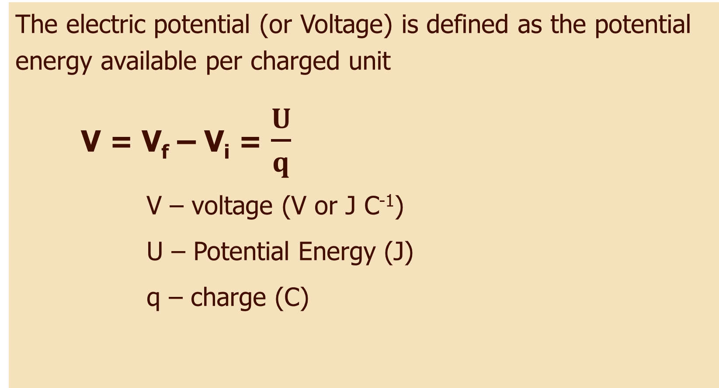
Electric Potential
The electric potential (or Voltage) is defined as the potential energy available per charged unit
V = V_{f} – V_{i} = $\frac{U}{q}$
V – voltage (V or J C⁻¹)
U – Potential Energy (J)
q – charge (C)

Slide 31
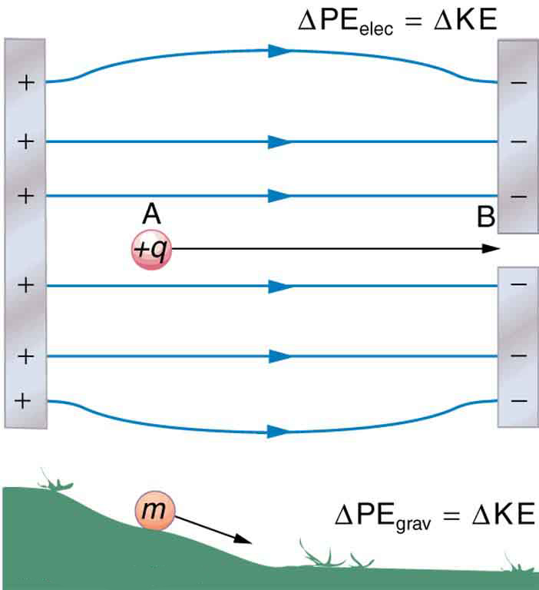
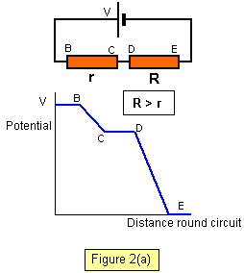
Electric Potential
It is like gravitational potential energy as it is the stored energy available for transformation into another form, i.e heat and in most
cases, kinetic energy.

Slide 32
Zero Potential Energy
The nature of potential energy is that the zero point is arbitrary; it can be set like the origin of a coordinate system. That is not to say that it is insignificant; once the zero of potential energy is set, then every value of potential energy is measured with respect to that zero.

Slide 33
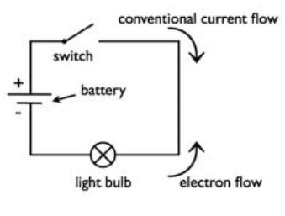
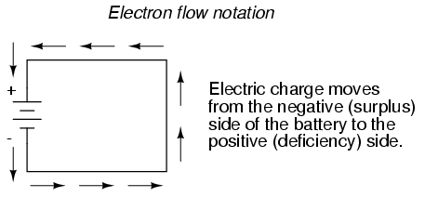
Electric Energy Flow
The rate of flow of electric charges, whether positive or negative is called an electric current.
Conventional Current is the flow from positive to negative.
Electron flow is from negative to positive.

Slide 34
Homework, Context & Keywords
Context: How is this content used to better society?
Understanding the pressure system of voltage to design more efficient and safer electrical devices

Slide 35
Homework, Context & Keywords
Key Words
Electric Potential difference
Zero Potential
Electric Circuits

Slide 36
Homework, Context & Keywords
Homework
Complete all questions from Set 3.3- due first lesson next week.
Read Chapter 4.1, page 96-104 and answer
Q1 Set 4.1
by next lesson.

Slide 37
Page Setup
Set up the first page of every lesson like this and rule a column line for every page after the first page that is used during the lesson.
Focus: State the Chapter Number, Title and the page numbers
(3 lines).
Keywords: During the lesson write out your own keywords used during the lesson. (8 lines)
Context: During the lesson write in this section what this topic relates to in the ‘real’ world. How is this content used to better society? (5 lines)

Slide 38
Magnetic Field
Chapter 4.1
Page 96 - 104

Slide 39
General Terminology
Like magnetic poles repel
Unlike magnetic poles attract
Magnetite is a natural magnetic rock
Dipolar means 2 poles (e.g. Earths poles, magnets)
Induced magnetism is where non-magnetic materials (e.g. iron) behave with magnetic properties when a permanent magnet is introduced.

Slide 40
Magnetic Field On A Wire

Slide 41
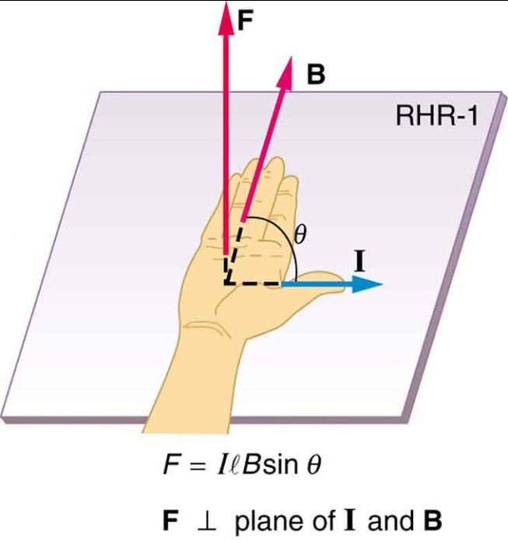
Magnetic Force On A WIRE
Whenever a current is flowing a magnetic field is produced.
The magnetic force is measured by
F = I l B⊥
F – magnet force (N)
I – current (A)
l – length of wire in field (m)
B⊥ – perpendicular magnetic flux density (T)
B⊥ – B sin θ where θ is the angle between I and B

Slide 42
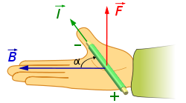
Magnetic Force On A WIRE
Using the Right Hand Rule for current and magnetic field, then given the direction of any two; the field, current or force, than the third unknown can be determined, both magnitude and direction.

Slide 43
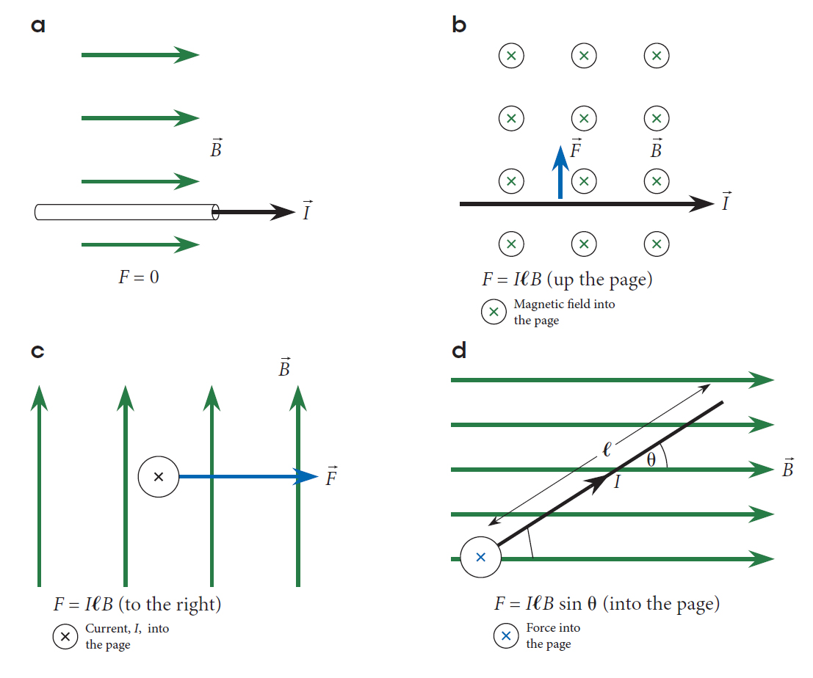
Magnetic Field On A WIRE
Practise finding the force on these

Slide 44
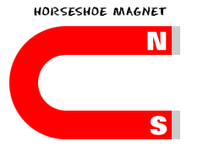
Magnetic Field On A WIRE
Example 4.1a: State or indicate the direction of the force acting on the current carrying conductor in each of the following by applying the right hand rule.
a) b) c)
d) e) f)
S
x x x x x x
x x x x x x
x x x x x x
x x x x x x
I
N
S
B
N
I
I
I
I
x
I
B
B

Slide 45
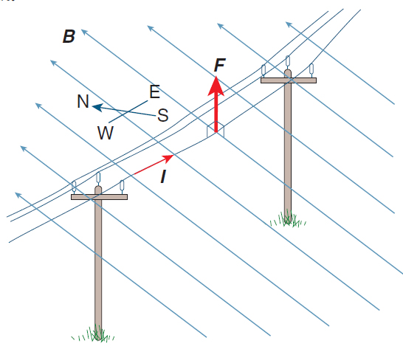
Magnetic Field On A WIRE
Example 4.1b: Determine the magnetic force per metre, due to the Earth’s magnetic field, on a suspended power line running east–west and carrying a
current of 100.0 A, as shown in
the diagram. Assume the Earth’s
magnetic flux density is
5.34 × 10^{–5} T.

Slide 46
Magnetic Field On A WIRE
Example 4.1c: A 0.200 m length of wire through which a current of 2.50 A is flowing, experiences a total force off 5.00 x 10⁻² N vertically downwards when at right angles to the magnetic field.
Draw a diagram showing the orientation of the field, current and force.
Determine the magnitude of the magnetic field strength
How could the force be increased?

Slide 47
Magnetic Field On A Point Charge

Slide 48
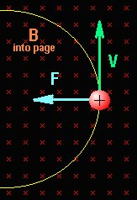
Magnetic Field on a Point Charge
If a charge passes through an area which already has a magnetic field, then there will be an interaction. That is, a force will be exerted on the particle.
The force applied will be at right angles to the motion of the particle, hence cause the particle to move in a circular path.

Slide 49
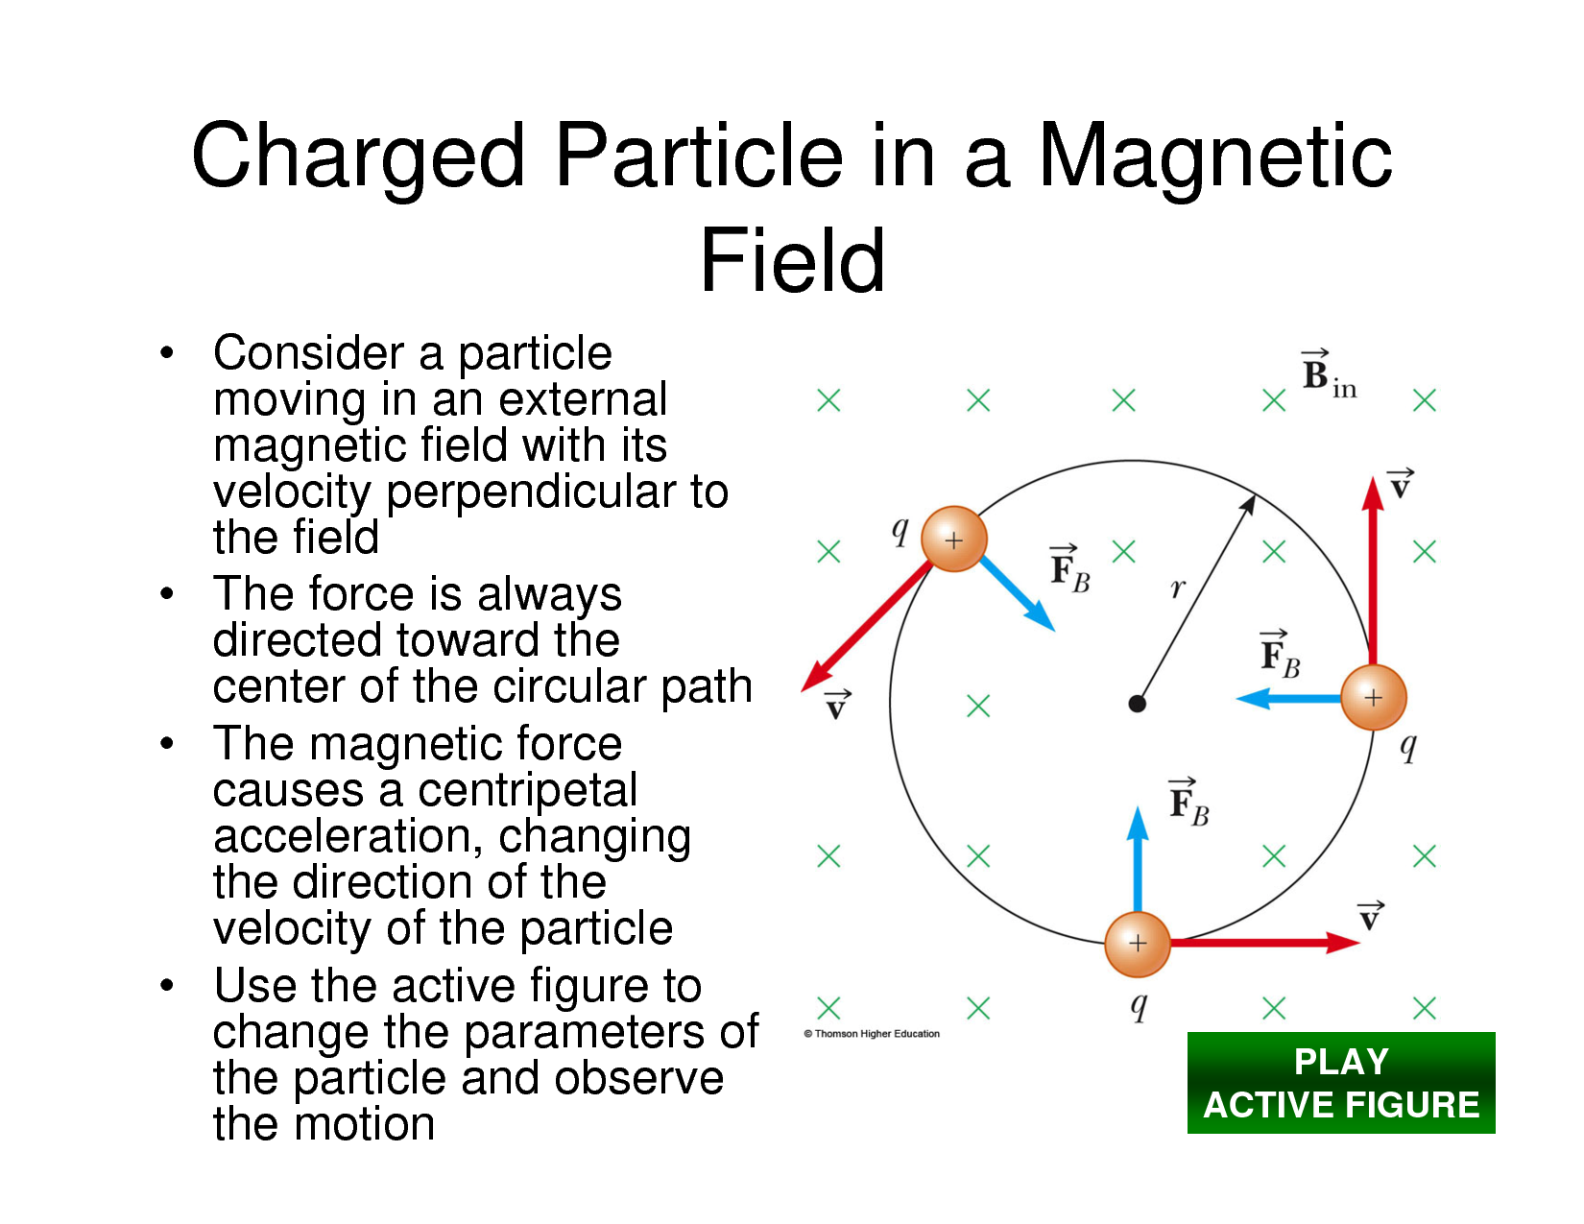
Magnetic Field on a Point Charge
The right hand rule still applies, except for current it is now velocity.
NOTE: This is for a positive charge. The negative charge would move in the opposite direction.
(OR LHR)

Slide 50
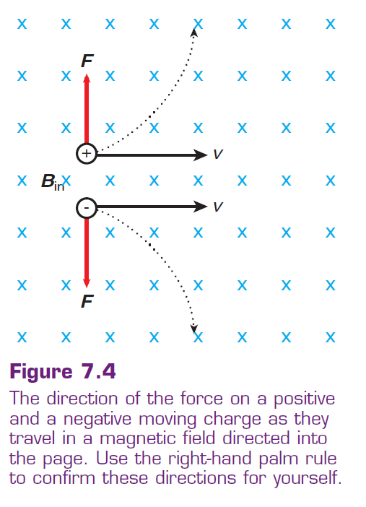
Magnetic Field on a Point Charge
Right hand rule:
Positive charge
Left hand rule:
Negative charge

Slide 51
Magnetic Field on a Point Charge
The charged particle (electron or positive ion) path is influenced by its speed and the strength of the magnetic field.
The electrostatic force on the charged particle is
F = q v B┴
F – electrostatic force (N)
q – charge of particle (C)
v – velocity of particle (m s⁻¹)
B┴ - perpendicular magnetic flux density (T)

Slide 52
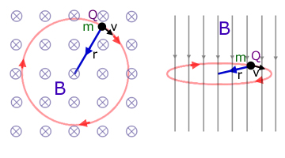
Magnetic Field on a Point Charge
Since the force of the particle is always at right angles to its motion, it is essentially centripetal force. Hence;
F_{c} = F_{E}
m v² = q v B┴
r
so r = m v . or v = r q B┴
q B┴ m
velocity is in a straight path and assumed to have no acceleration
v = s
t , where for a circular path s = 2 π r
Hence 2 π r = r q B┴ or T = 2 π m
T m q B┴

Slide 53
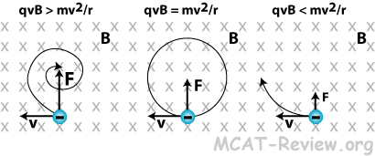
Magnetic Field on a Point Charge
Particles pathway

Slide 54
Magnetic Field on a Point Charge
Example 4.1d: An electron beam in a T.V tube is moving horizontally eastwards towards the screen at 2.1 x 10⁷ ms⁻¹ as it passes through a deflecting magnetic field. The magnetic field is 8.25 x 10⁻³ T vertically out (out of the page).
a) In which direction is the electron deflected?
b) Calculate the force exerted on the electron and the consequent acceleration.
c) What affect will this have on the electron?

Slide 55
Magnetic Field on a Point Charge
Example 4.1d:
F
B
e⁻
B
v
LHR for electrons
Hence the Force pushes the electron upwards.

Slide 56
Magnetic Field on a Point Charge
Example 4.1e: A proton initially at rest is accelerated horizontally due East through a potential difference of 45 kV. It then enters a vertical (out of the page) magnetic field of 0.25 T at a speed of 2.94 x 10⁶ ms⁻¹. Determine ;
a) The force exerted on the proton by the magnetic field.
b) Draw the orbital path, including correct orientation.
c) The radius of the orbital path
+
+

Slide 57
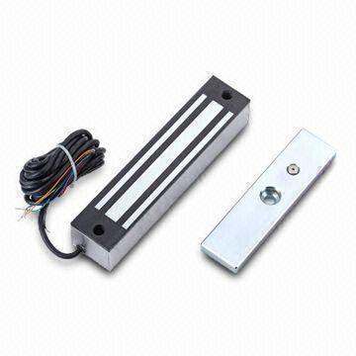

Magnetic Force Examples
A door catch is a simple device that uses
the magnetic force of attraction to hold a
door closed.
Computer hard drives
use magnetism to store the data on a
rotating disk.

Slide 58
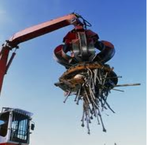
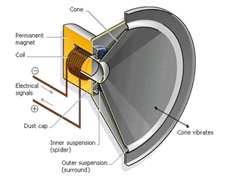
Magnetic Force Examples
An industrial application of magnetic force is an electromagnetic crane that is used for lifting
metal objects.
Loudspeakers use an
electric current flowing through a
coil to generate a magnetic field.
This field interacts with the field of
a permanent magnet to make a
diaphragm move and produce
sound.

Slide 59
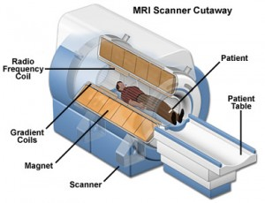
Magnetic Force Examples
There are applications of magnetic force in medical science. X-ray and scanning devices rely on electromagnetic action. MRI scanners are Magnetic
Resonance Imaging devices,
and they are used in hospitals
to create 3D images of body
parts.

Slide 60
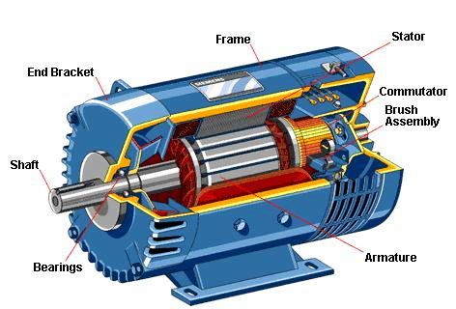
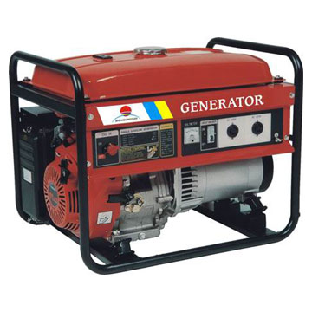
Magnetic Force Examples
Electric motors use the
electromagnetic force between a
magnet and a current carrying coil to
produce movement.
Electric generators use the
electromagnetic force between a
magnet and a moving coil to
generate electrical energy.

Slide 61
Homework, Context & Keywords
Context: How is this content used to better society?
Understanding the behaviour of a charge in a magnetic field has lead to many advances in the field of atoms. With this understanding, the mass spectrometer was developed, leading to precise calculations of elements within a compound.

Slide 62
Homework, Context & Keywords
Key Words
Magnetic force
Magnetic field
Right hand rule
Charges
Electrostatic

Slide 63
Homework, Context & Keywords
Homework
Complete all questions from Set 4.1- due first lesson next week.
Read Chapter 4.2, page 105-119 and answer
Q1, Q2 & Q3 Set 4.2
by next lesson.

Slide 64
Page Setup
Set up the first page of every lesson like this and rule a column line for every page after the first page that is used during the lesson.
Focus: State the Chapter Number, Title and the page numbers
(3 lines).
Keywords: During the lesson write out your own keywords used during the lesson. (8 lines)
Context: During the lesson write in this section what this topic relates to in the ‘real’ world. How is this content used to better society? (5 lines)

Slide 65
SOURCES & TYPES
Chapter 4.2
Page 105 - 119

Slide 66
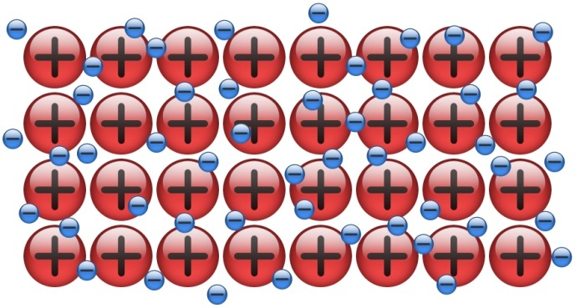
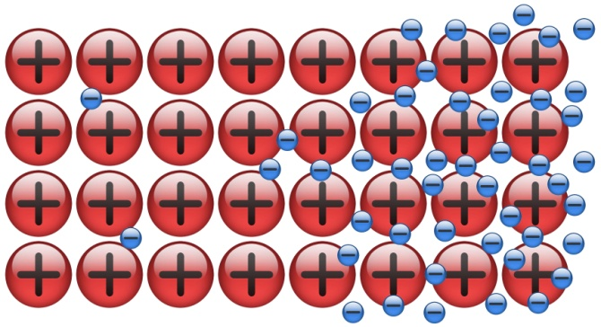
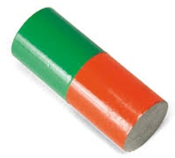
Induced Magnetism
.
Metallic materials consist of positive ions surrounded by free electrons.
Introduce the north side of a magnet and all the electrons in the metal are attracted and move to the side of the metal closest to the magnet.
This produces a positive and negative side of the metal, hence it behaves like a magnet.
Positive
Negative

Slide 67
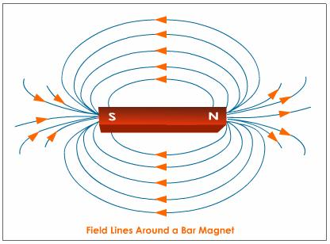
Direction of the Magnetic Field
The magnetic field lines run North to South.

Slide 68
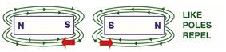
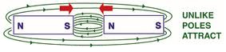
Direction of the Magnetic Field
Like Poles
Unlike Poles

Slide 69
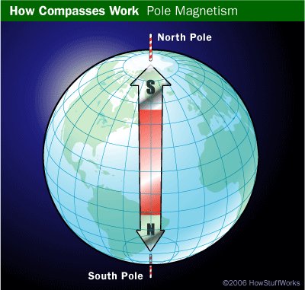
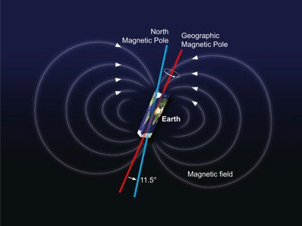
Earths Magnetism
Think of the Earth as having a gigantic bar
magnet buried inside. In order for the north
end of the compass to point toward the
North Pole, you have to assume that the
bar magnet inside the Earth has its south end
at the North Pole, as shown in the diagram at the right. The
normal "opposites attract" rule of magnets cause the north end of the compass needle to point toward the south end of the buried bar magnet. So the compass points toward the North Magnetic Pole.

Slide 70
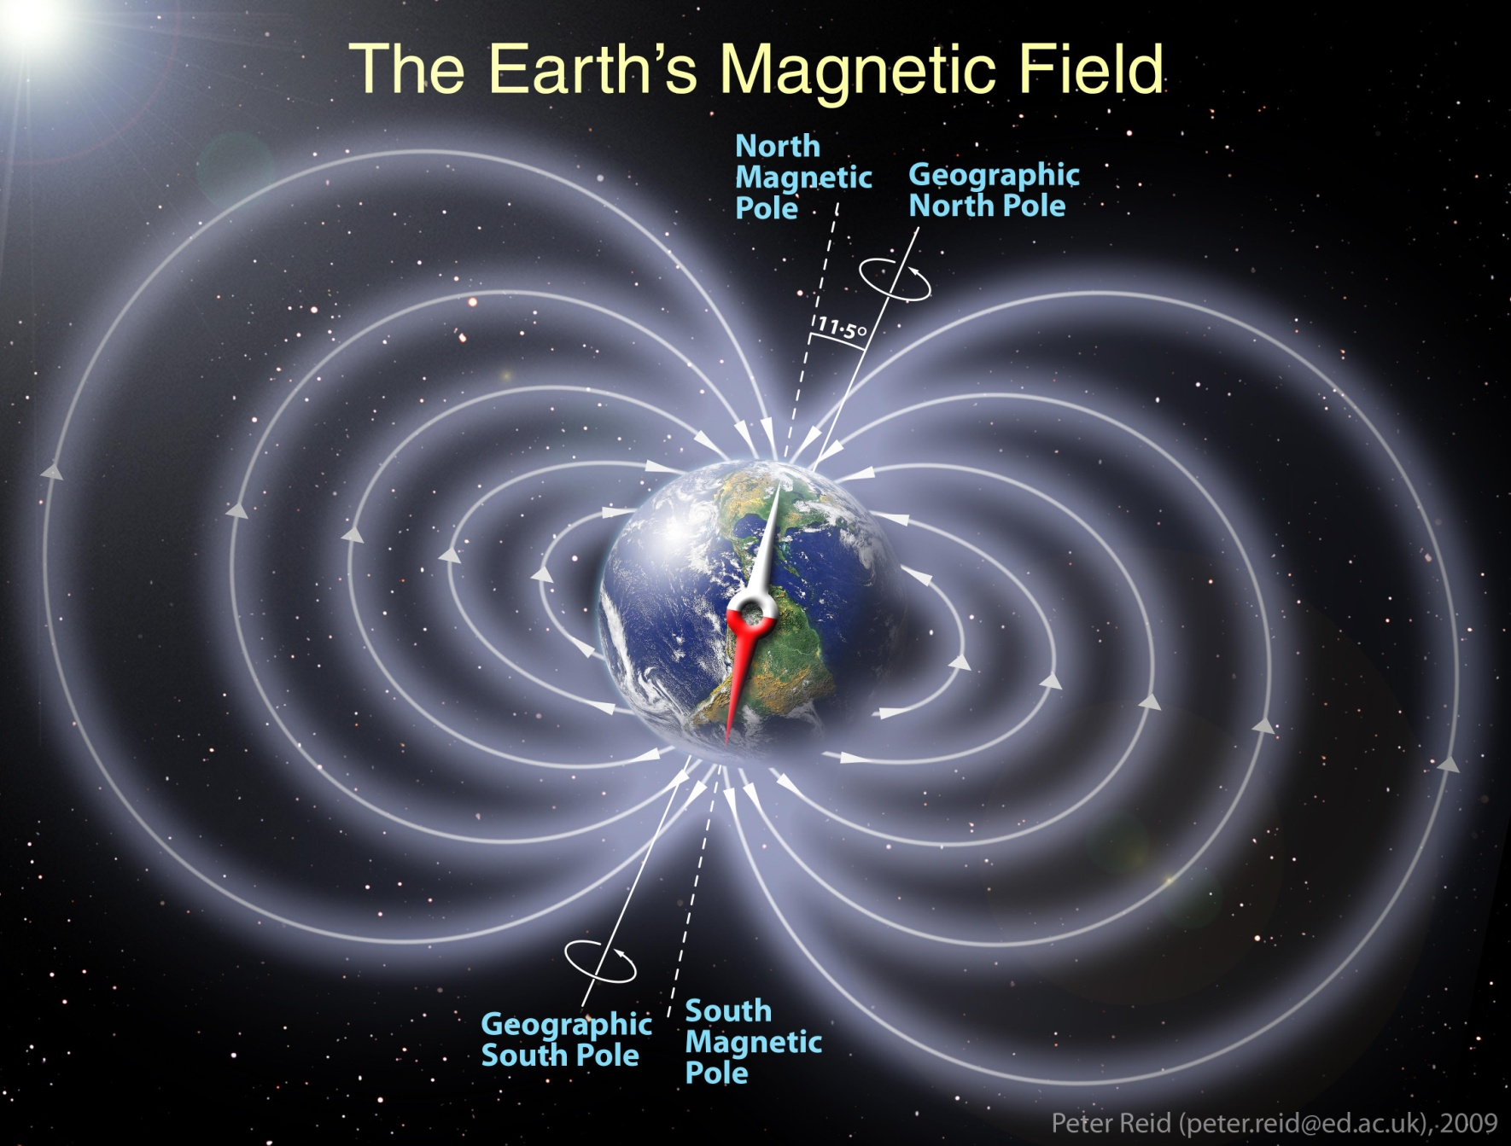
Earths Magnetism
The Geographic North pole attracts the north end of compasses and magnets so it has to be a south pole.

Slide 71
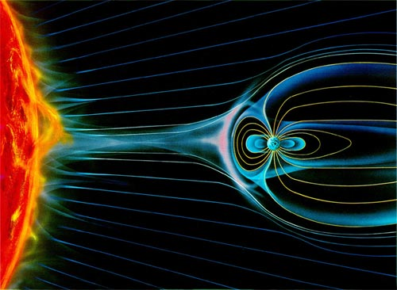
Earths Magnetism
The solar winds from the Sun would strip the Earth of all living matter if it weren’t for the magnetic field and its density protecting us.

Slide 72
Magnetic Vectors
Vectors are used to analyse and compare the magnetic flux densities of two or more fields.
Example 4.2a: Two magnets and a compass are placed as shown. If the north/south facing magnet has twice
the flux density as the east/west magnet, what
would the needle in the compass show? And with
what strength?
S
N
N S
Compass

Slide 73
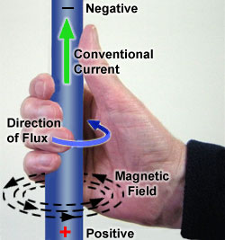
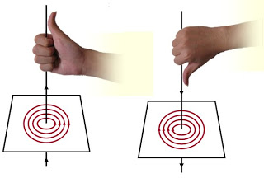
Magnetic Field created by a Current
When a current flows through a wire,
this creates a magnetic field.
The direction of the magnetic field is determined by the “right hand grip” rule.
The thumb points in the same direction as the current flows.

Slide 74
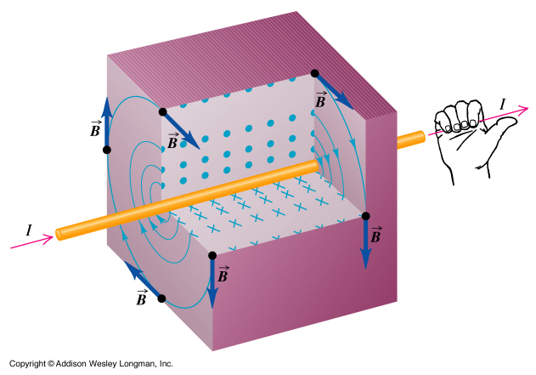
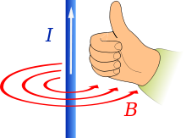
Magnetic Field created by a Current

Slide 75
Magnetic Field created by a Current
Example 4.2b: Two wires as shown, have a current running through them. Find the direction of the force applied to each wire due to the induced magnetic fields.
X
Y
I
I

Slide 76
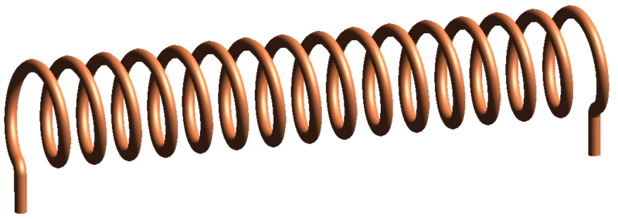
Solenoids
Firstly, what is a Solenoid?
In physics, the term refers specifically to a long, thin loop of wire, often wrapped around a metallic core, which produces a uniform magnetic field in a volume of space (where some experiment might be carried out) when an electric current is passed through it. Solenoids are important because they can create controlled magnetic fields and can be used as electromagnets.

Slide 77
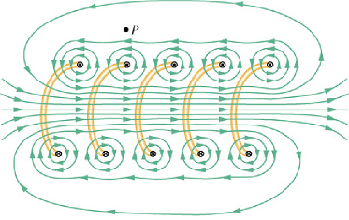
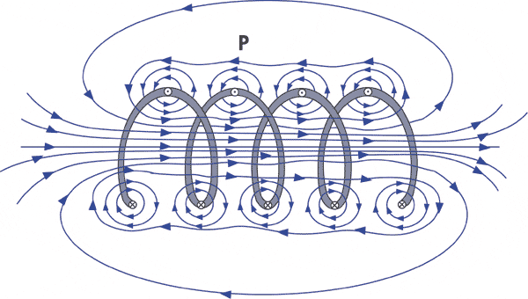
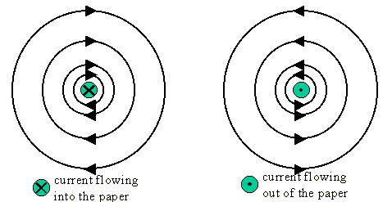
Solenoids
Determining the polarity of a solenoid when a current is passed through the wire.
When observing the single wires in a given plane, the magnetic field can be very distinct in the direction it is flowing, hence North and South ends of a Solenoid can be found. (Treat it like any other magnet)
S
N

Slide 78
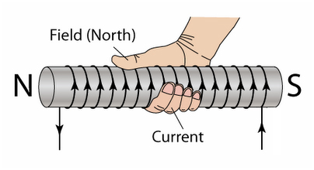

Solenoids
Determining the polarity of a solenoid using the right hand grip rule.
The fingers follow the path of the current around the core and the thumb will indicate the north direction.

Slide 79



Solenoids

Slide 80

Solenoids
.

Slide 81
Magnetic Flux Density
B = μ_{o} I .
2π r
μ_{o} – permeability of free space
= 4 π x 10⁻⁷ T m A⁻¹
B – magnetic flux density (Tesla) or Magnetic Field
r – distance of the field from the wire (m)
I – current (A)

Slide 82
Magnetic Flux Density
B = μ_{o} I .
2π r
Note: if r ↑ or I ↓ then B ↓
if r ↓ or I ↑ then B ↑
Magnetic Flux Density and Magnetic Field are the same thing.
Magnetic Flux (φ) and Magnetic Flux Density (B) are different

Slide 83

Magnetic Flux Density
Example 4.2c: A 36 amp current is flowing through a wire.
a) Calculate the magnetic field that it creates at 1 cm radial intervals from the wire for 5 intervals.
b) Compare this to the Earth’s
average magnetic field of 45 μT.
c) Did you expect these results to
be a linear or exponential
change, explain why.

Slide 84

Magnetic Fields Summary

Slide 85
Homework, Context & Keywords
Context: How is this content used to better society?
How the magnetic field in wires can disrupt the current flow in neighbouring wires and hence, damage electrical equipment.

Slide 86
Homework, Context & Keywords
Key Words
Magnetic Flux Density
Earth’s Magnetism
North Pole
Solenoids
Solar winds
Magnet Vectors
Induced Magnetism
Permeability of Free Space

Slide 87
Homework, Context & Keywords
Homework
Complete all questions from Set 4.2- due first lesson next week.
Read Chapter 5.1, page 124-133 and answer
Q1 & Q2 Set 5.1
by next lesson.

